Slide 1

Performance Analysis of

Slide 2
Content Findings Management by Exception Tables Background of Blinkit Data Analysis Roles Objectives Operational efficiency and delivery optimization Inventory and product management Sales and revenue analysis Customer behavior and retention Customer feedback and sentiment Marketing performance Product-level analysis Conclusion

Slide 3
Findings
Late delivery due to traffic is an important issue in the Delivery process.
Late delivery is an important reason for negative sentiment among consumers.
Consumers also have negative sentiments about the product quality and customer service.
Spinach has a maximum risk of wastage.
Dairy and breakfast-related products have the maximum contribution to revenue.
Credit/debit Cards are the most favourite payment method of Blinkit’s consumers.
New customers have a maximum average order value.
All the campaign channels have almost similar Return on Ad spend (ROAS).
Flash sales are the most effective marketing campaign to attract targeted consumers.

Slide 4
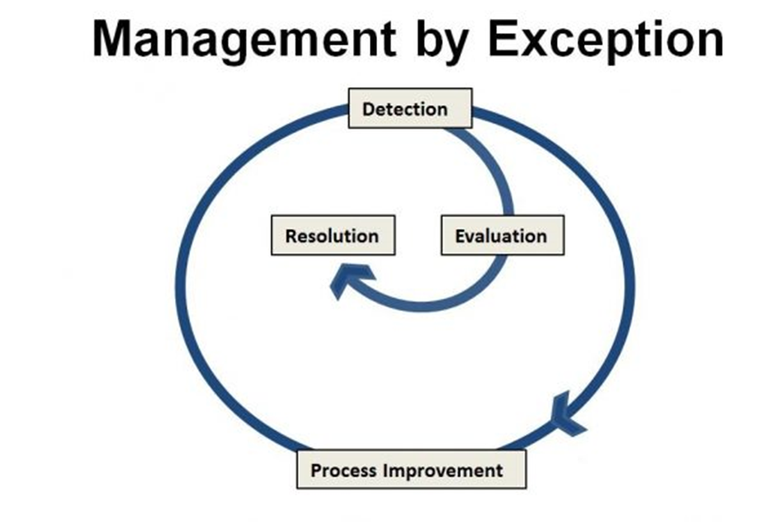
Management by Exception
Management by exception is applied for performing data analysis task.
As per Management by Exception the following tasks are performed in this research process:
1. Analysis of existing business operations and strategy.
2. Detection of business problems.
3. Resolution of those business problems.
4. Evaluation of business solution
5. Determine new goals based on suggested solutions for process improvement.

Slide 5
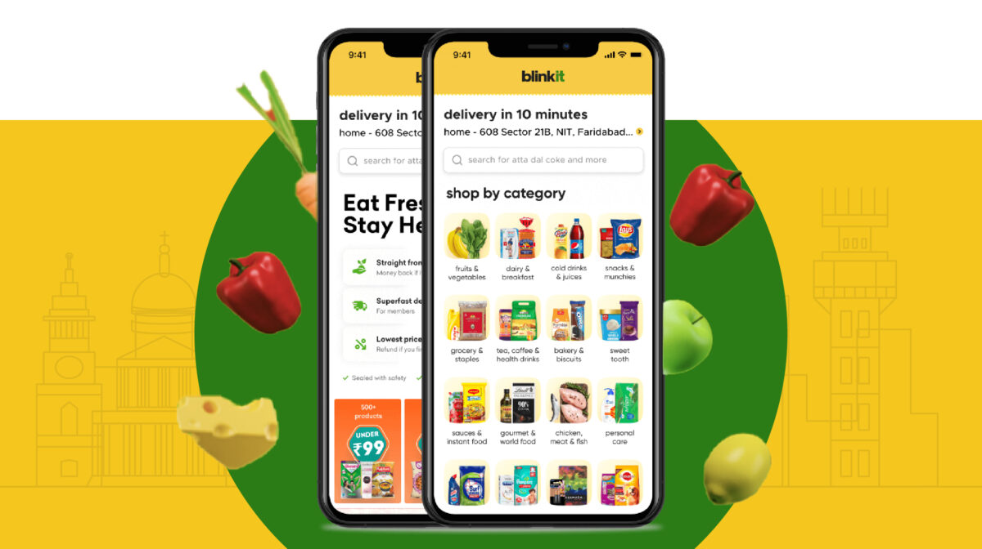
Tables
Blinkit orders
Blinkit Products
Blinkit customers
Blinkit delivery
Blinkit customer feedback
Blinkit inventory
Blinkits inventory new
Blinkit Marketing

Slide 6

Background of Blinkit
Blinkit is one of the largest hyper e-commerce companies of India in the Grocery segment.
Blinkit was founded in 2013
In 2022 Blinkit was acquired by Zomato with US$568 million.
Albinder Dhindsa is the current CEO of Blinkit
In 2024 the revenue of Blinkit was 23.01 billion INR.
Current market value of BlinkIt is US$13 Billion.

Slide 7

Data Analysis
The following data are analyzed in MYSQL:
1. 5000 unique orders
2. 2172 unique customers
3. 5000 different delivery partners
4. 5000 unique stores
5. 51 unique products
6. 11 different categories of products
7. 9 different marketing campaigns
8. 4 campaign channels

Slide 8

Roles
Role performed during data analysis:
1) Operation Analyst
2) Logistic Analyst
3) Revenue analyst
4) Consumer analyst
5) Service analyst
6) Marketing analyst
7) Product analyst

Slide 9

Objectives
The data analysis on Mysql will be performed for the following process development of Blinkit:
1) Operational efficiency and delivery optimization
2) Inventory and product management
3) Sales and revenue department
4) Customer behavior and retention
5) Customer feedback and sentiment
6) Marketing performance
7) Product level analysis

Slide 10
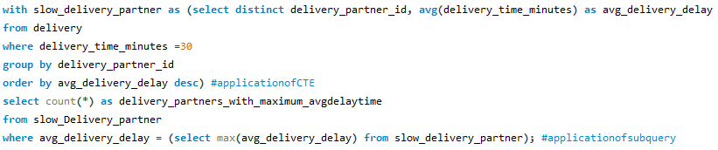
Operational efficiency and delivery optimization (Role: Operation Analyst)
Delivery partners with late delivery issues
Following Delivery partners require to be warned as their Average delivery delay is 30 minutes is maximum:
62428, 33556, 24964, 98726, 92844, 65001, 246, 69366, 8913, 43612, 67215, 86820, 47082, 43823, 15287, 22930, 68579, 17689, 99317, 22021, 95971, 70720, 39675, 93983, 91747, 34016, 17189, 65591, 94212, 61678
Strategy
Blinkit should arrange some training sessions or discuss with these partners to get an idea about the solutions related to late delivery issues

Slide 11
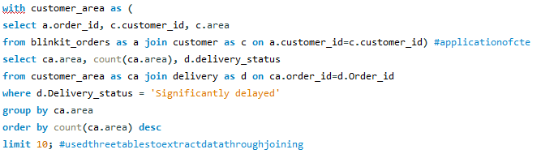
Operational efficiency and delivery optimization (Role: Operation Analyst)
315 Areas are determined with significant late delivery
New delivery partners should deploy in the following areas to resolve issues
Areas with late delivery problems

Slide 12
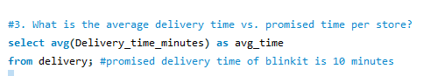
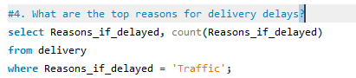
Operational efficiency and delivery optimization (Role: Operation Analyst)
Analysis of Delivery Time
1) The national average delivery time of Blinkit is 4 minutes 27 seconds.
2) The promised delivery time of Blinkit is 10 minutes.
3) ‘Traffic’ is the only reason for 3098 late delivery.
Strategy
Recruiting more delivery partners to reduce the distance from the store to the consumer’s house can be effective in reducing late delivery for traffic.

Slide 13
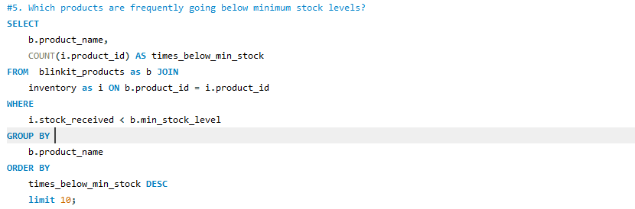
Inventory and product management (Role: Logistic Analyst)
The following products go to below-minimum stock levels:

Slide 14
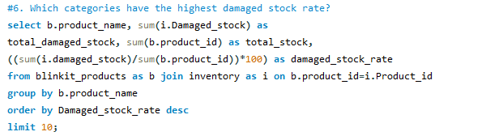
Inventory and product management (Role: Logistic Analyst)
The following products have a maximum damaged stock rate:

Slide 15
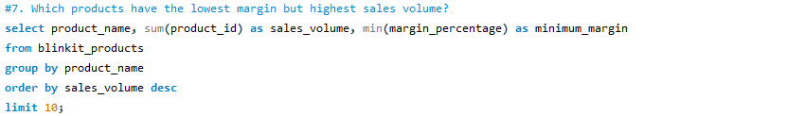
Inventory and product management (Role: Logistic Analyst)
The following products have the highest sales volume and minimum margin:

Slide 16
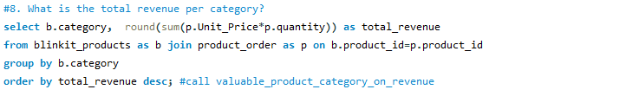
Sale and revenue analysis (Role: Revenue Analyst)
Total revenue per category
The following product categories have maximum contributions to the sales of Blinkit:

Slide 17
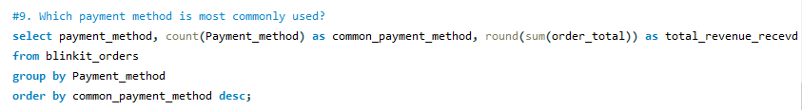
Sale and revenue analysis (Role: Revenue Analyst)
Payment method

Slide 18
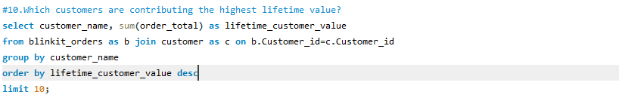
Sale and revenue analysis (Role: Revenue Analyst)
Lifetime valued customers

Slide 19
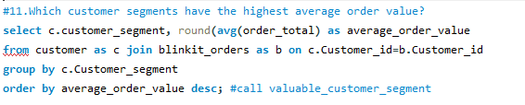
Customer behavior and retention (Role: Consumer Analyst)
Average order value
The following Customer segments have maximum Average order value:

Slide 20
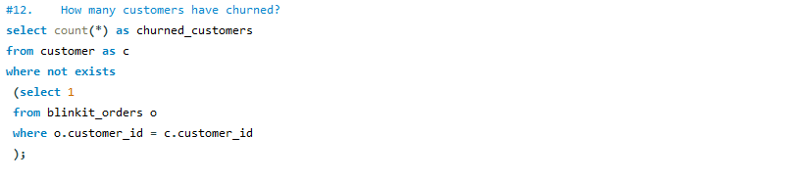
Customer behavior and retention (Role: Consumer Analyst)
Churned customers
328
customers churned recently from Blinkit

Slide 21
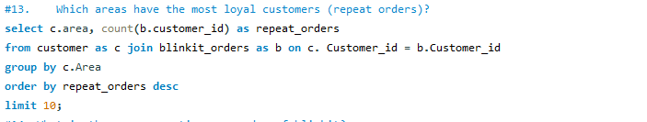
Customer behavior and retention (Role: Consumer Analyst)
Loyal customers
The following areas have the maximum number of loyal customers of Blinkit:

Slide 22
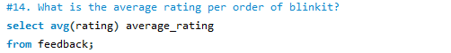
Customer feedback and sentiment (Role: Service Analyst)
Rating to delivery services
3.34
Average rating of delivery services out of 5

Slide 23
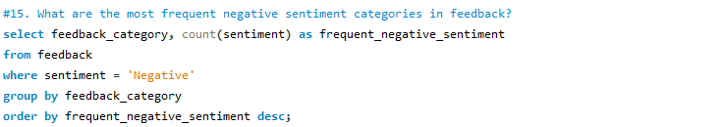
Customer feedback and sentiment (Role: Service Analyst)
Service categories
The following service categories have the most negative sentiments:

Slide 24
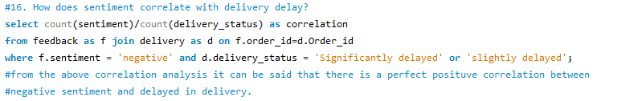
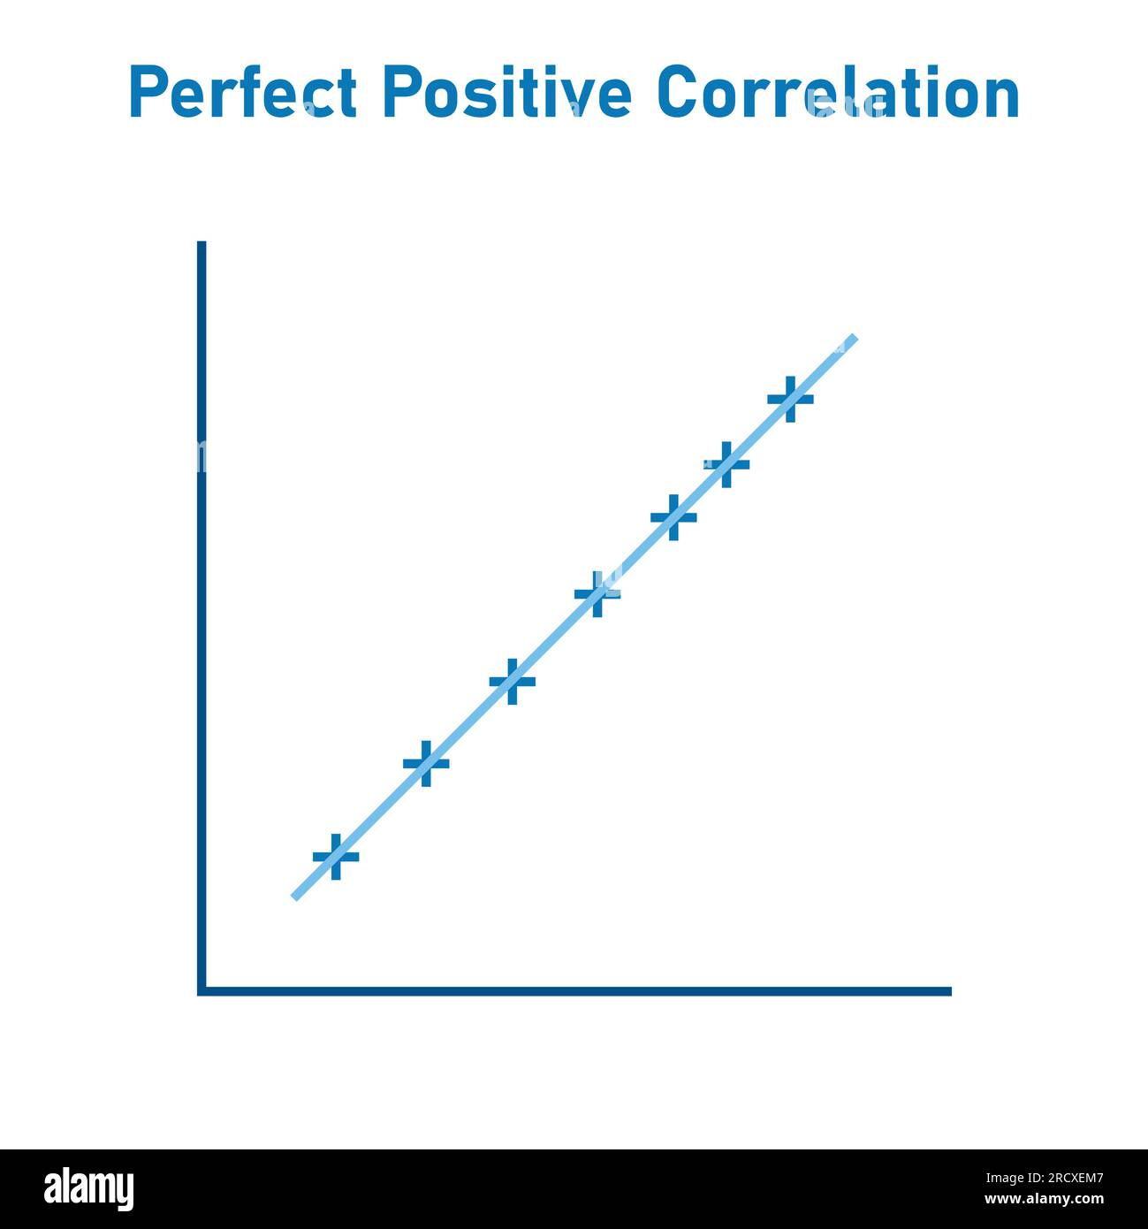
Customer feedback and sentiment (Role: Service Analyst)
Correlation
The correlation between negative sentiment and late delivery is
1

Slide 25
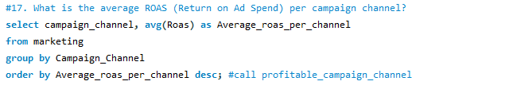
Marketing performance
(Role: Marketing Analyst)
Return on Ad Spend
Blinkit use the following campaign channels to implement the marketing campaigns:

Slide 26
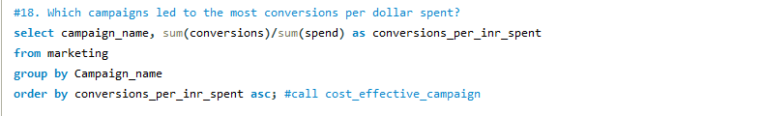
Marketing performance
(Role: Marketing Analyst)
Conversion per dollar
The following 9 campaigns are initiated by Blinkit:

Slide 27
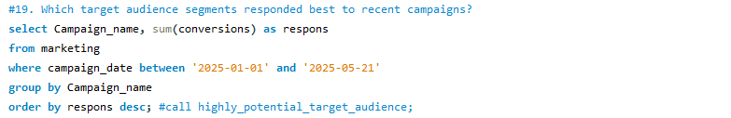
Marketing performance
(Role: Marketing Analyst)
Reviewing recent campaigns

Slide 28
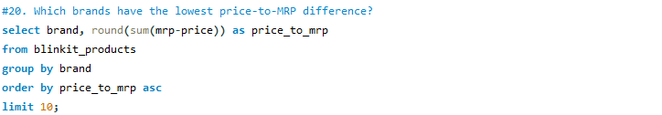
Product-level analysis
(Role: Product Analyst)
Price to mrp difference

Slide 29
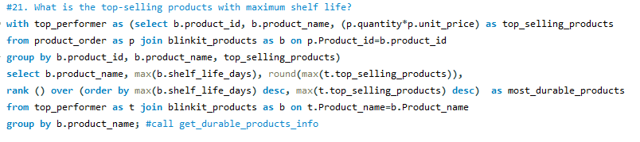
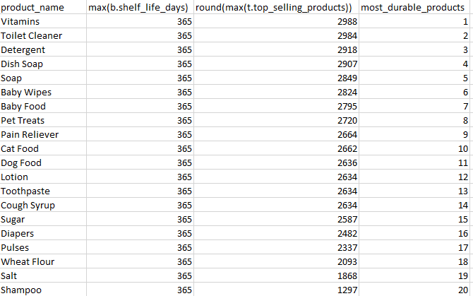
Product-level analysis
(Role: Product Analyst)
Top performers with maximum shelf life

Slide 30

CONCLUSION
Consumers love Blinkit.
Consumers have high expectations from Blinkit.
Blinkit can satisfy these expectations by improving product quality and customer service.
Blinkit also should take immediate action to reduce the frequency of late delivery.
Blinkit should take feedback from consumers regularly.
Products also should have additional stocks as per consumer demand and shelf-life.
Happy customers and Happy Delivery Partners are the major componenst of continuous growth of Blinkit.

